Slide 1








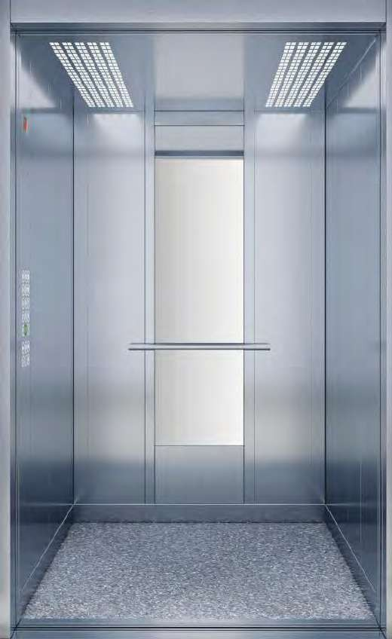
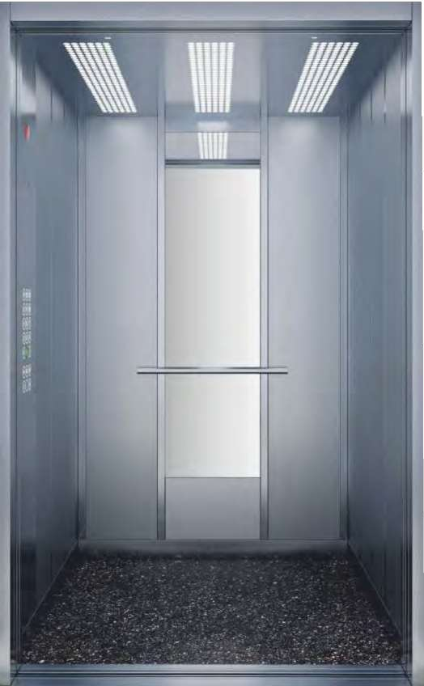





YOLCU
YOLCU
PKAASBSİENNLGEERRİ
PKAASBSİENNLGEERRİ
CABINS
CABINS
Model
Model
KURUMSAL
PİKAN
Model Türü
Model Türü
Dikey
Dikey
Model
Model
Kaplama
Kaplama
3T0ü4rü
PTaüsrlüanma
PSastilnaenma
z
z
Kaplama
Kaplama
KNodkut
SKaotdinu
a
e
Tavan GMToVde- li
Tavan
03
GMToVde- li
01
Zemin
Zemin
GMroadneili
GMroadneili
t
t
Model
Model
KURUMSAL
PİKAN
Model
Model
Vertical
Vertical
Model
Model
Interior
Interior
SCaotaintinSgtainless
SCtoaaintilnegss
Steel
Steel
Coating
Coating
SCaotdie
CDotde
n
Style
Ceiling
Ceiling
GMToVd-el
GMToVd-el
01
03
Floor
Floor
GMroadneitl
GMroadneitl
e
e
3
6
www.betaasansor.com / 4 4 4 2
704
www.betaasansor.com / 4 4 4 2
704
3
7

Slide 2

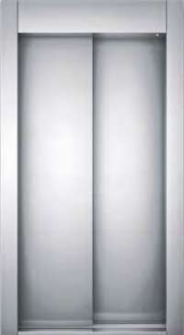
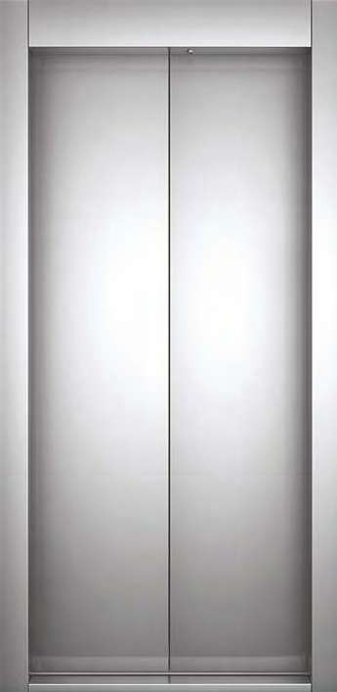
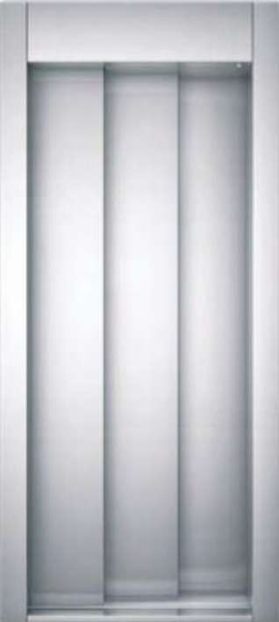


KAPILAR
KAPILAR
DOOR
DOORS
S
Otomatik 2 Panel Teleskopik
Otomatik 2 Panel Merkezi
Otomatik 3 Panel Teleskopik
Otomatik 4 Panel Merkezi Kapı
AKuatpoımatic 2 Panel Telescopic
AKuatpoımatic 2 Panel Central
Kapı
Automatic 4 Panel Central
Door
Door
Automatic 3 Panel Telescopic
Door
Door
52
www.betaasansor.com / 4 4 4 2
704
www.betaasansor.com / 4 4 4 2
704
53

Slide 3

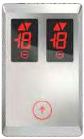

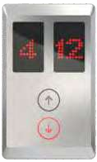




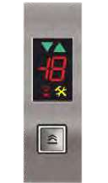
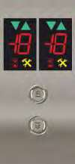




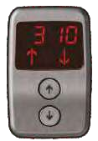
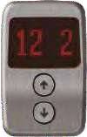

KASETLER &
KASETLER & BUTONLAR
BCUOTNOTRNOLLARPANELS &
CONTROL PANELS &
BUTTONS
BUTTONS
BT 01
BT
BT
BT
02
03
04
BT
BT
BT
BT
05
06
07
08
KB 01
KB 02
KB 03
KB 04
T A M BOY
Full Lenght
YARIM BOY
T A M BOY
Full Lenght
T A M BOY
Full Lenght
Half Lenght
BT 09
BT
BT 11
10
5 6
www.betaasansor.com / 4 4 4 2
704
www.betaasansor.com / 4 4 4 2
704
57

